Slide 1
Sorting Algorithms

Slide 2
Why Study Sorting Algorithms?
There are a variety of situations that we can encounter
Do we have randomly ordered keys?
Are all keys distinct?
How large is the set of keys to be ordered?
Need guaranteed performance?
Various algorithms are better suited to some of these situations

Slide 3
Some Definitions
Internal Sort
The data to be sorted is all stored in the computer’s main memory.
External Sort
Some of the data to be sorted might be stored in some external, slower, device.
In Place Sort
The amount of extra space required to sort the data is constant with the input size.

Slide 4
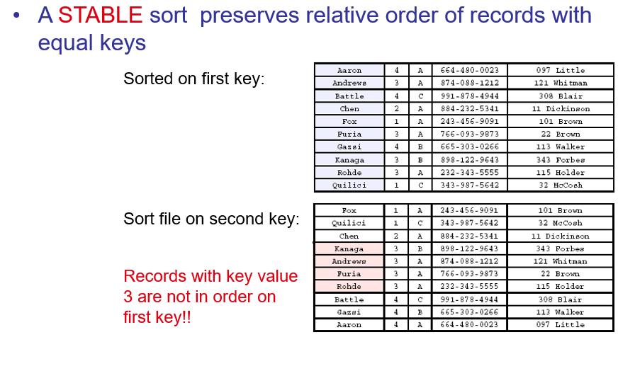
Stability

Slide 5
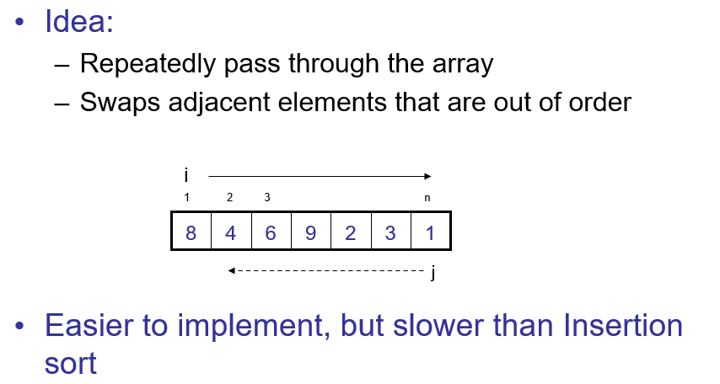
Bubble Sort

Slide 6
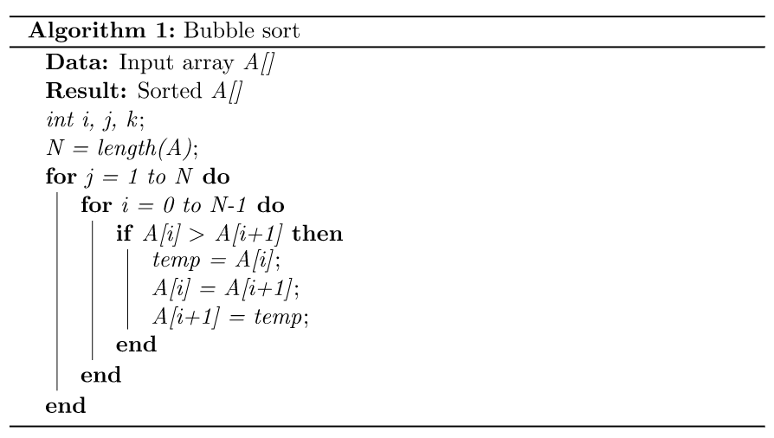
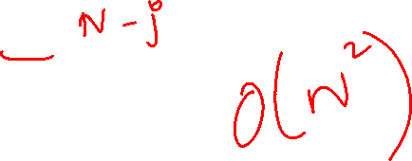
Bubble Sort

Slide 7
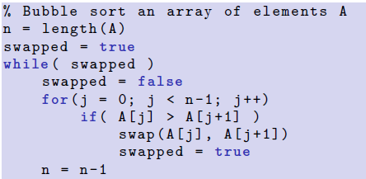
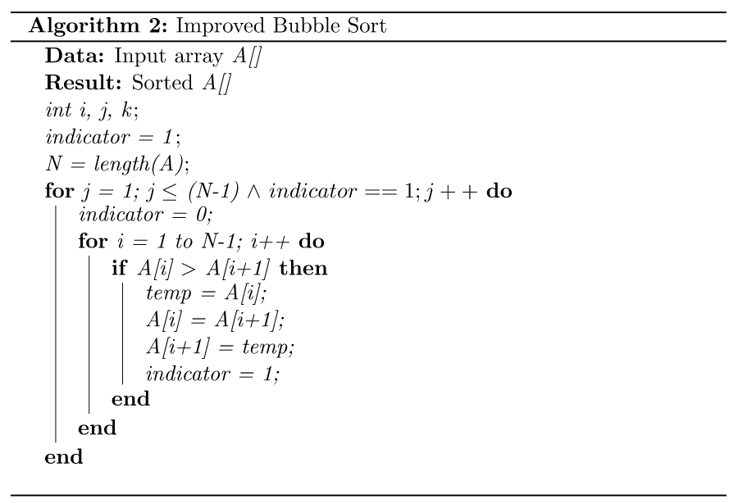
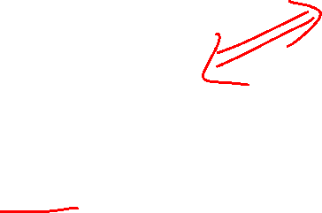
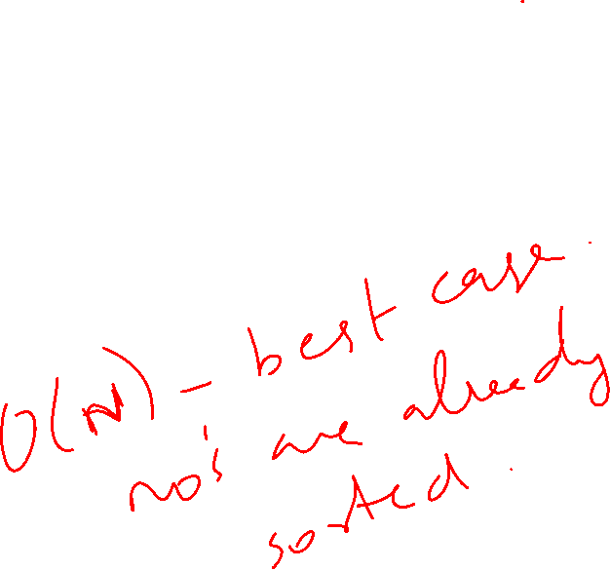
Bubble Sort
0

Slide 8
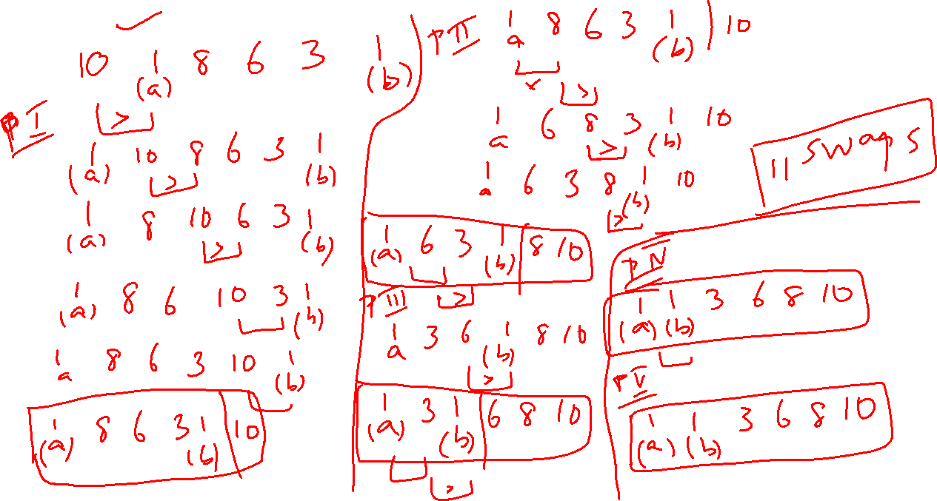

Slide 9
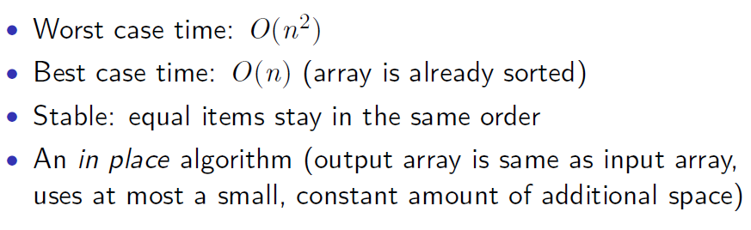
Bubble Sort - Analysis

Slide 10
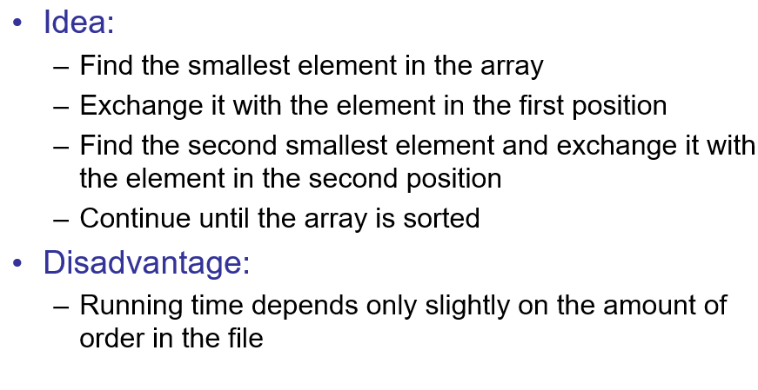
Selection Sort

Slide 11
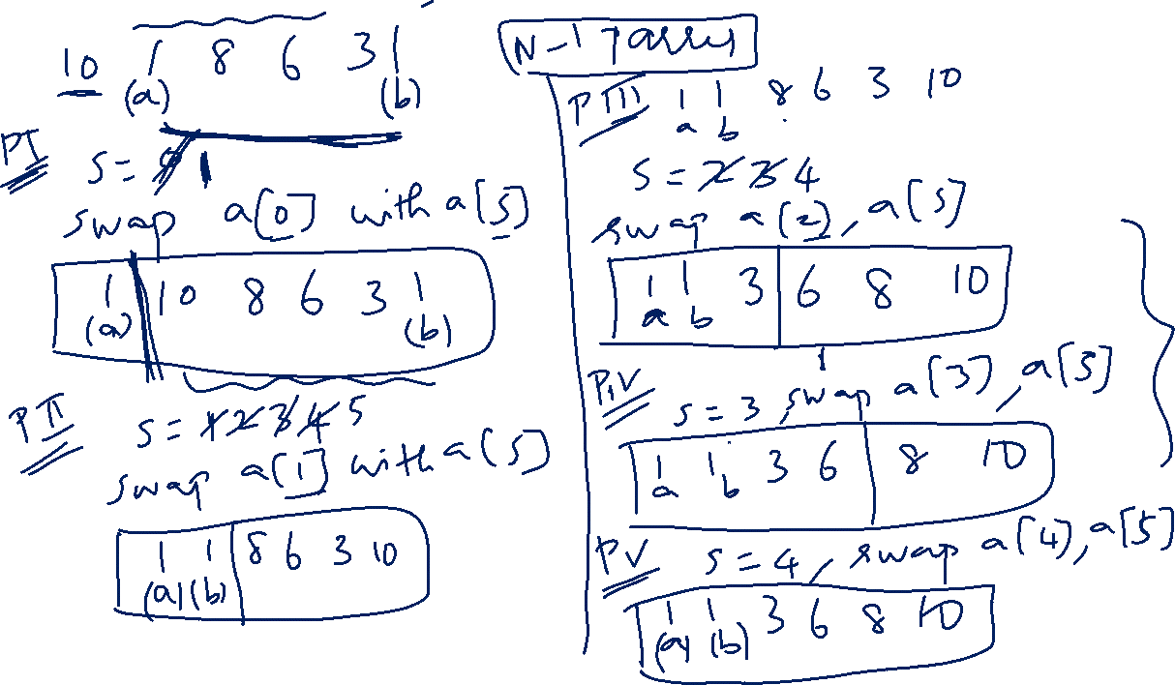

Slide 12
Selection Sort
Alg.: SELECTION-SORT(A)
n ← length[A]
for j ← 0 to n - 1
do smallest ← j
for i ← j + 1 to n
do if A[i] < A[smallest]
then smallest ← i
exchange A[j] ↔ A[smallest]

Slide 13
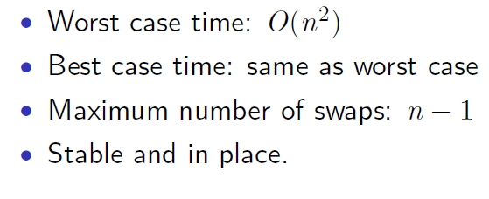
Selection Sort
Mostly stable, but for cases like array containing 2, 2, 1, or 4, 2, 4, 1 it is not stable

Slide 14
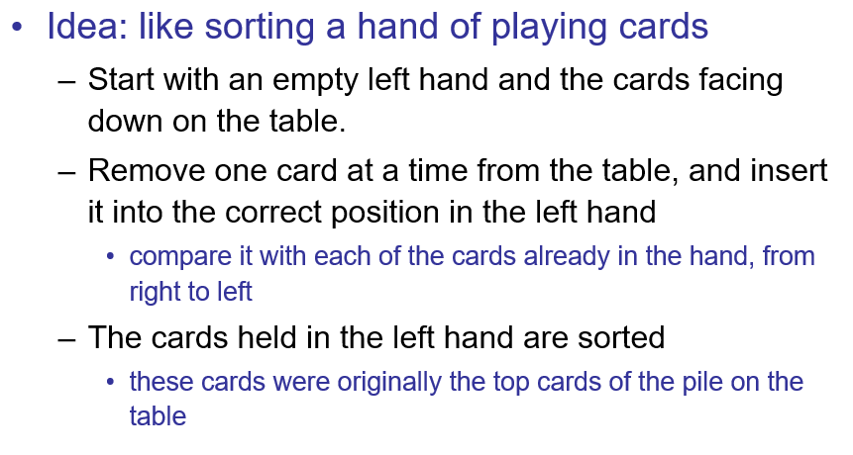
Insertion Sort

Slide 15
Insertion Sort
To insert 12, we need to make room for it by moving first 36 and then 24.
6
10
24
36
12

Slide 16
Insertion Sort
6
10
24
36
12

Slide 17
Insertion Sort
6
10
24
36
12

Slide 18
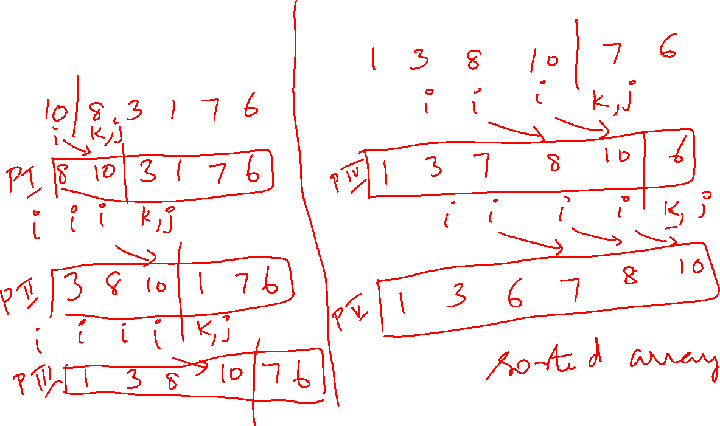
Insertion Sort

Slide 19
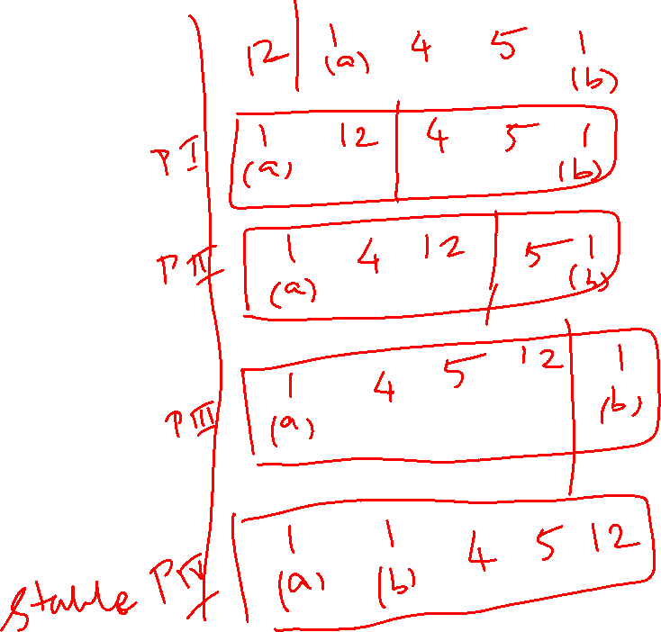
Insertion Sort
Alg.: INSERTION-SORT(A)
for j ← 1 to n
do key ← A[ j ]
Insert A[ j ] into the sorted sequence A[1 . . j -1]
i ← j - 1
while i >= 0 and A[i] > key
do A[i + 1] ← A[i]
i ← i – 1
A[i + 1] ← key
Insertion sort – sorts the elements in place

Slide 20
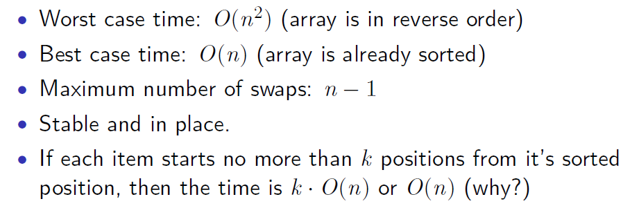
Insertion Sort
k.O(n)

Slide 21
Heap Sort
Heap Sort Algorithm for sorting in increasing order:
Step 1: Build a max heap from the input data.
Step 2: At this point, the largest item is stored at the root of the heap.
Replace it with the last item of the heap followed by reducing
the size of heap by 1. Finally, heapify the root of the tree.
Step 3: Repeat step 2 while size of heap is greater than 1.

Slide 22
Heap Sort
Input Array Min Heap Max Heap

Slide 23
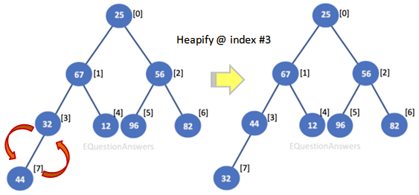
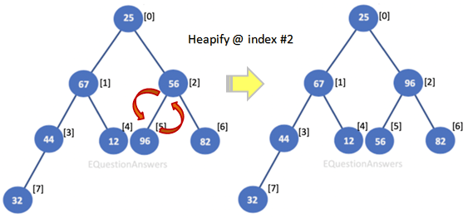
Heap Sort

Slide 24
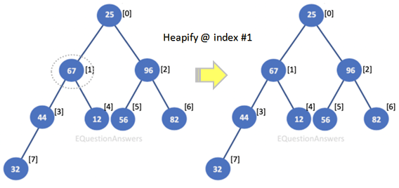
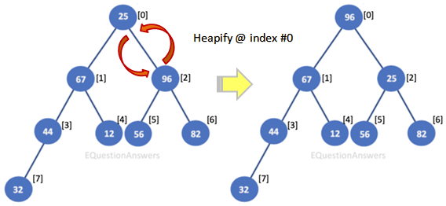
Heap Sort

Slide 25
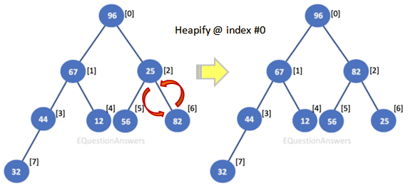
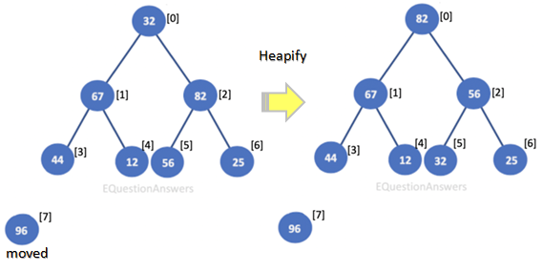
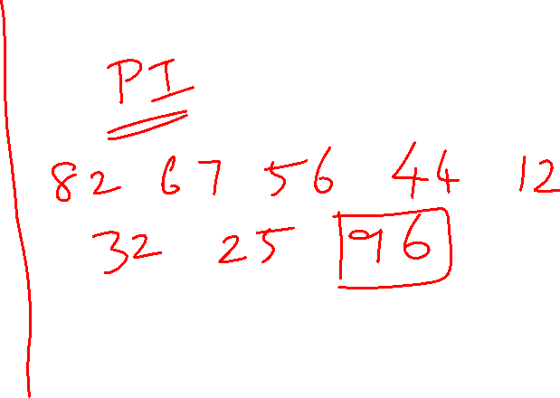
Heap Sort

Slide 26
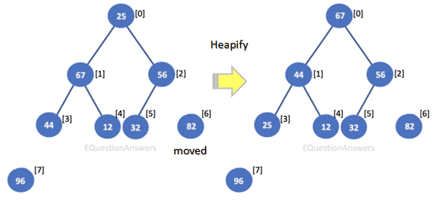
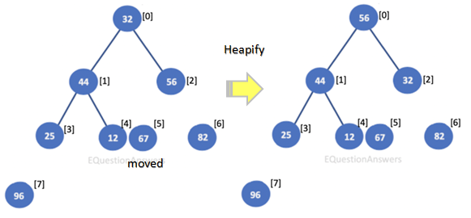
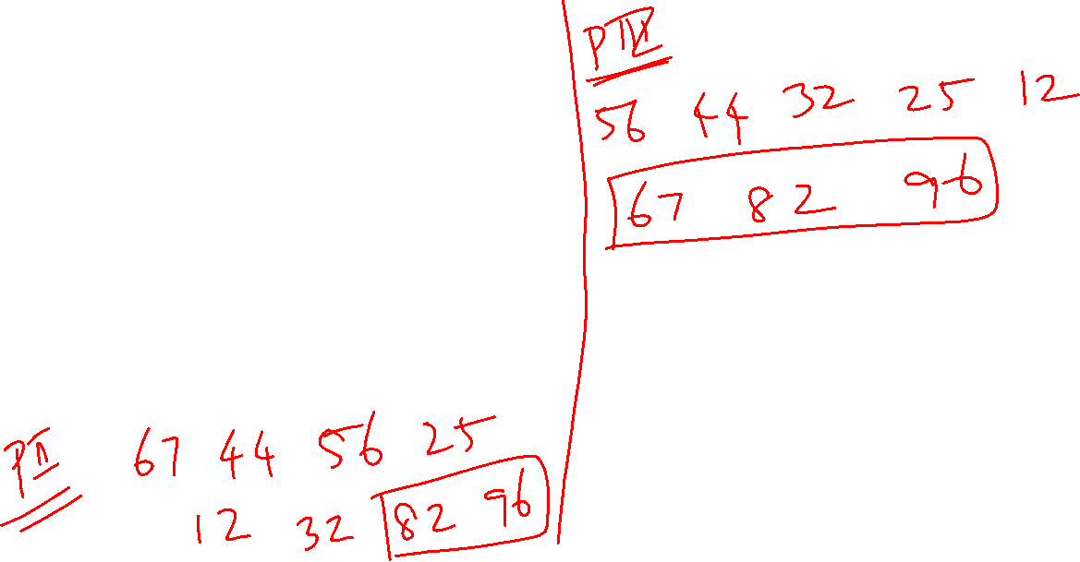
Heap Sort

Slide 27
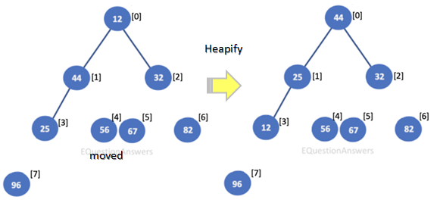
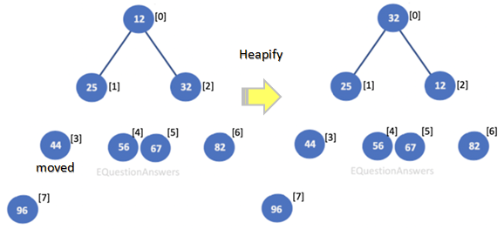
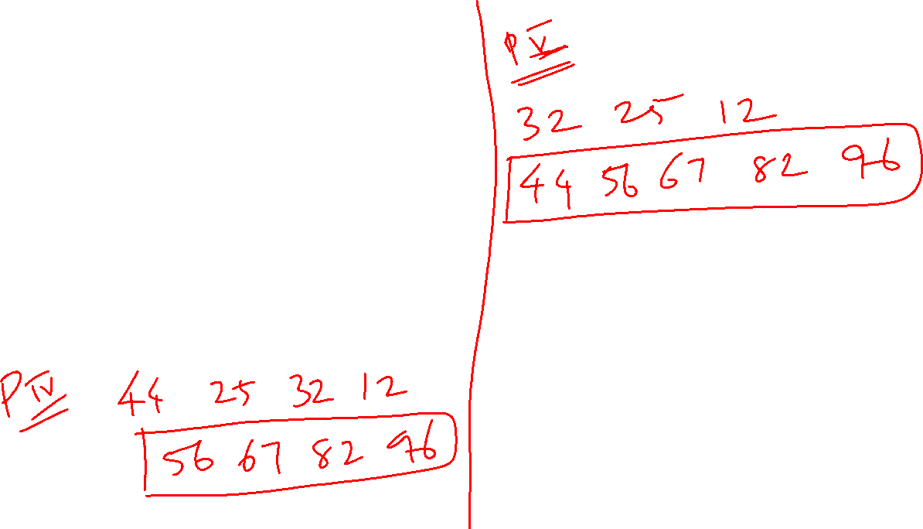
Heap Sort

Slide 28
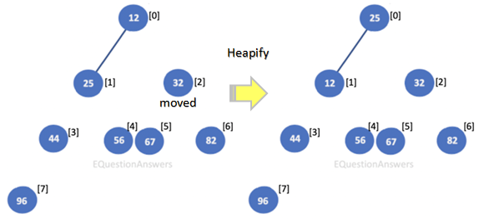
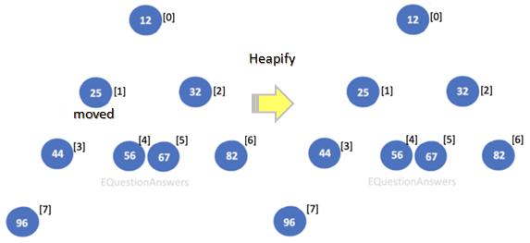
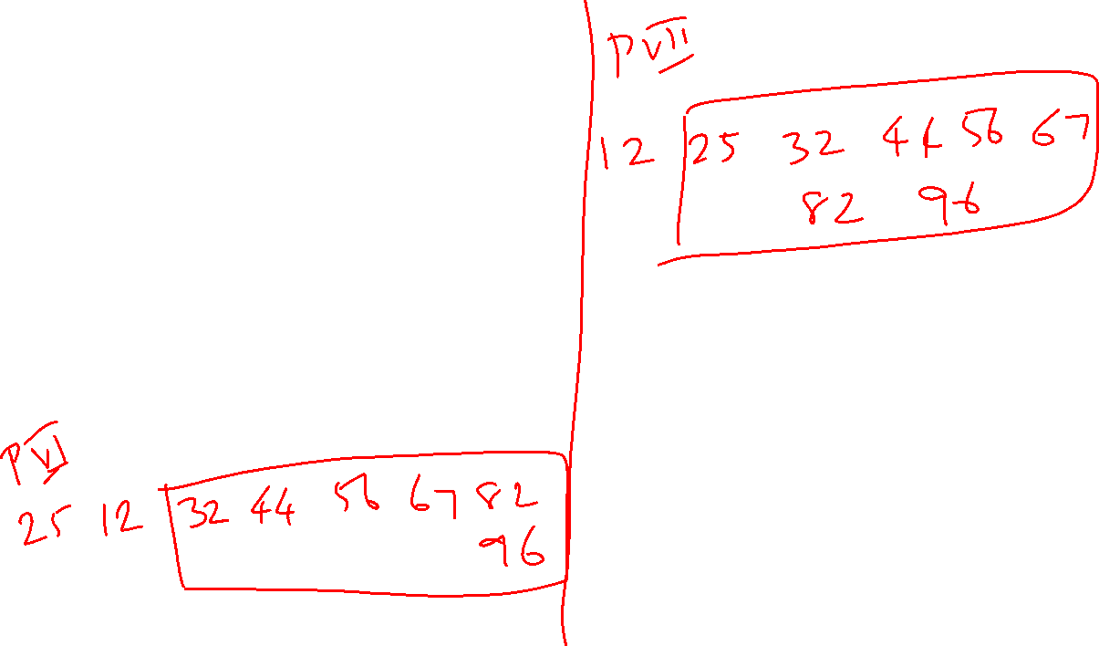
Heap Sort

Slide 29
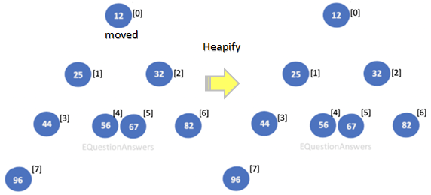
Heap Sort
Sorted array is 12 25 32 44 56 67 82 96

Slide 30
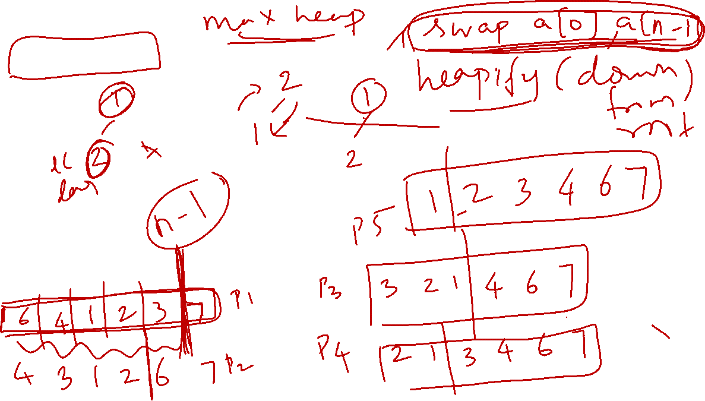
Heap Sort

Slide 31
Heap Sort
void heapify(int arr[], int n, int i)
{
int largest = i; // Initialize largest as root
int l = 2 * i + 1; // left = 2*i + 1
int r = 2 * i + 2; // right = 2*i + 2
// If left child is larger than root
if (l < n && arr[l] > arr[largest])
largest = l;
// If right child is larger than largest so far
if (r < n && arr[r] > arr[largest])
largest = r;
// If largest is not root
if (largest != i) {
swap(arr[i], arr[largest]);
// Recursively heapify the affected sub-tree
heapify(arr, n, largest);
}
}

Slide 32
Heap Sort
// main function to do heap sort
void heapSort(int arr[], int n)
{
// Build heap (rearrange array)
for (int i = n / 2 - 1; i >= 0; i--)
heapify(arr, n, i);
// One by one extract an element from heap
for (int i = n - 1; i > 0; i--) {
// Move current root to end
swap(arr[0], arr[i]);
// call max heapify on the reduced heap
heapify(arr, i, 0);
}
}

Slide 33
Heap Sort
Time complexity
Heapify is O(Logn).
createAndBuildHeap() is O(n)
overall time complexity of Heap Sort is O(nLogn).
Heap sort is an in-place algorithm.
Its typical implementation is not stable, but can be made stable

Slide 34
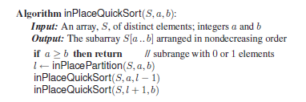
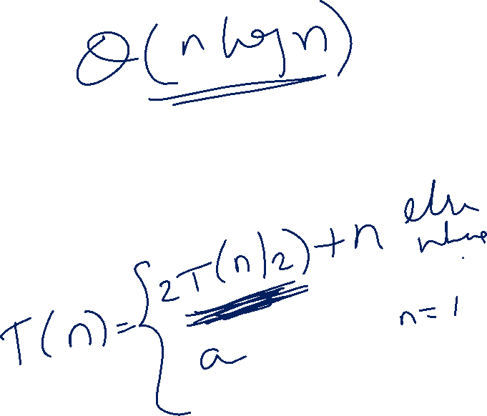
Quick Sort

Slide 35
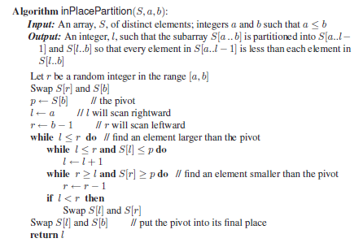
Quick Sort

Slide 36
Quick Sort
Worst Case: The worst case occurs when the partition process always picks greatest or smallest element as pivot. O(n²)
Best Case: The best case occurs when the partition process always picks the middle element as pivot. O(nLogn)
Average Case: O(nLogn)
The default implementation is not stable. However, any sorting algorithm can be made stable by considering indexes as comparison parameter.
in-place sorting algorithm

Slide 37
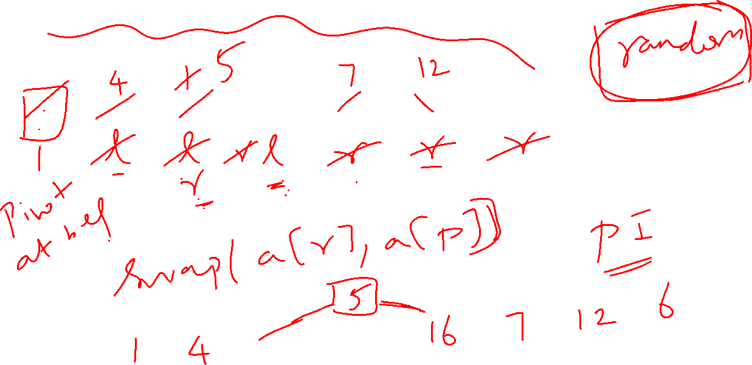
Quick Sort

Slide 38
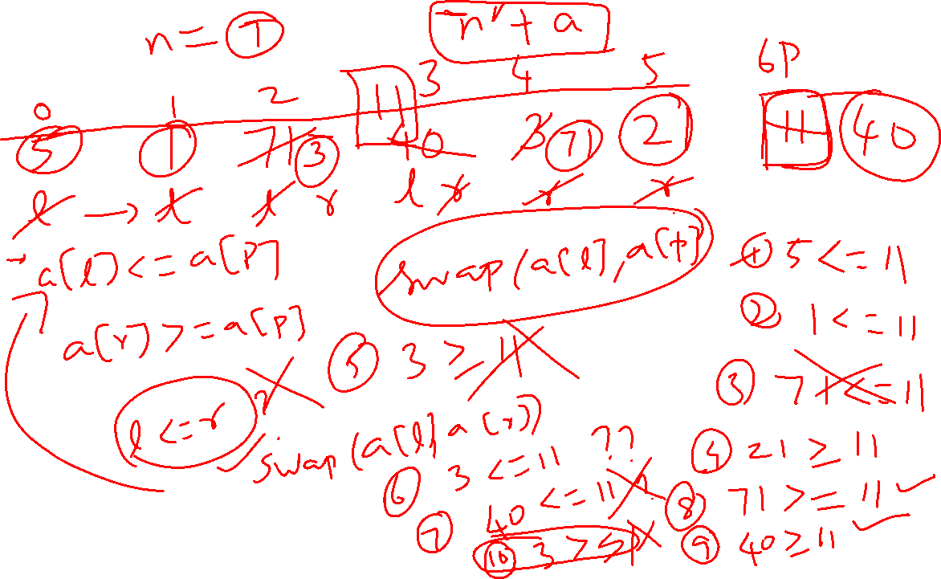
Quick Sort

Slide 39
QuickSelect
A selection algorithm related to Quick sort to find the k-th smallest (or largest) element in an unordered list
After partitioning around a pivot, the algorithm does not recurse on both subarrays.
It recurses only on the subarray that may contain the k-th smallest element.
If the pivot index > k, recur on the left subarray.
If the pivot index = k, the k-th smallest element is found, so return it.
If the pivot index < k, recur on the right subarray.
Because only one side is processed each time, the expected time complexity reduces from O(n log n) to O(n).
The worst-case time complexity remains O(n²) (when partitions are highly unbalanced).

Slide 40
QuickSelect Algorithm
QUICKSELECT(A, low, high, k)
if low == high
return A[low]
p = PARTITION(A, low, high)
if p == k
return A[p]
else if k < p
return QUICKSELECT(A, low, p-1, k)
else
return QUICKSELECT(A, p+1, high, k)

Slide 41
Merge Sort
void merge(int arr[], int l, int m, int r)
{
int n1 = m - l + 1;
int n2 = r - m;
// Create temp arrays
int L[n1], R[n2];
// Copy data to temp arrays L[] and R[]
for (int i = 0; i < n1; i++)
L[i] = arr[l + i];
for (int j = 0; j < n2; j++)
R[j] = arr[m + 1 + j];
// Merge the temp arrays back into arr[l..r]
// Initial index of first subarray
int i = 0;
// Initial index of second subarray
int j = 0;
// Initial index of merged subarray
int k = l;

Slide 42
Merge Sort
while (i < n1 && j < n2) {
if (L[i] <= R[j]) {
arr[k] = L[i];
i++;
}
else {
arr[k] = R[j];
j++;
}
k++;
}
// Copy the remaining elements of L[], if there are any
while (i < n1) {
arr[k] = L[i];
i++;
k++;
}
// Copy the remaining elements of R[], if there are any
while (j < n2) {
arr[k] = R[j];
j++;
k++;
}
}

Slide 43
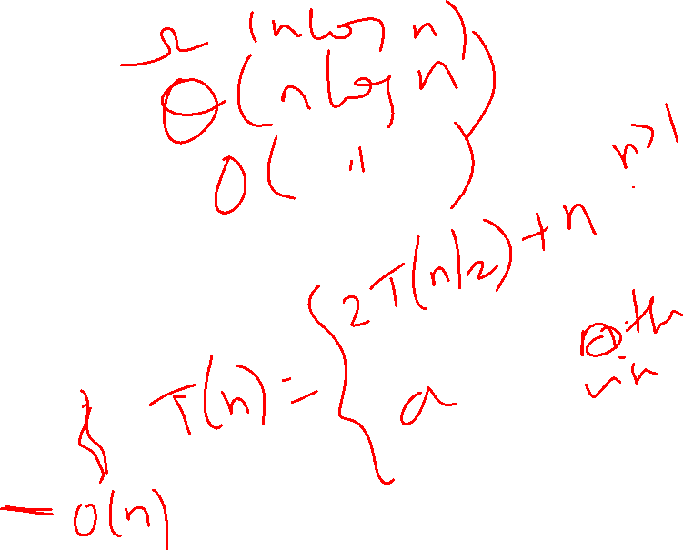
Merge Sort
void mergeSort(int arr[],int l,int r){
if(l>=r){
return;//returns recursively
}
int m =l+ (r-l)/2;
mergeSort(arr,l,m);
mergeSort(arr,m+1,r);
merge(arr,l,m,r);
}

Slide 44
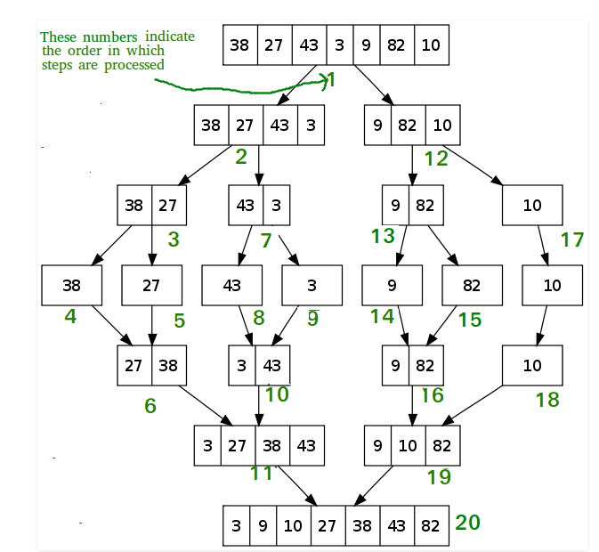
Merge Sort

Slide 45
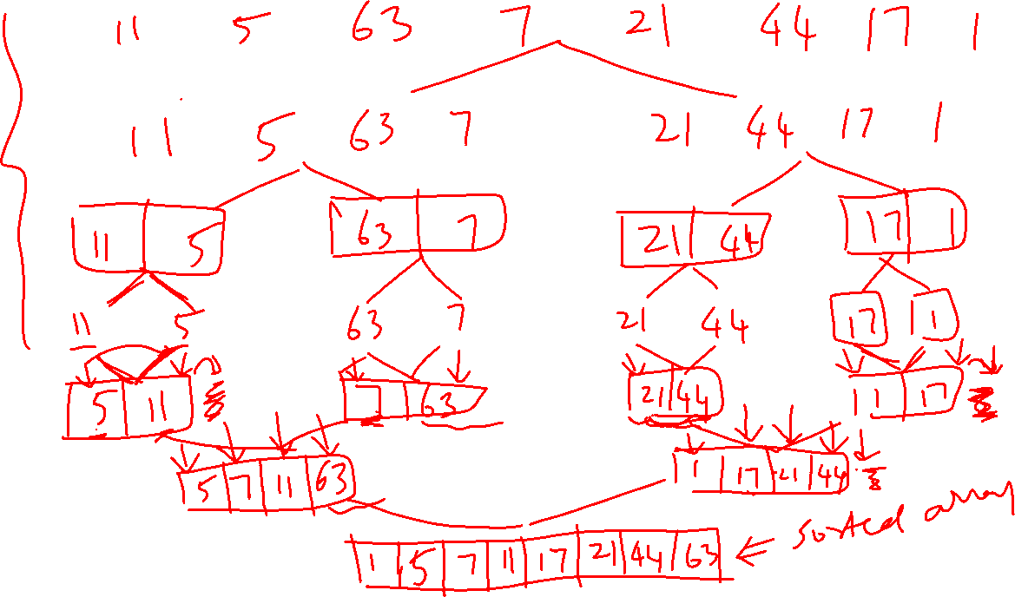

Slide 46
Merge Sort
Time Complexity
Worst Case Time Complexity [ Big-O ]: O(n*log n)
Best Case Time Complexity [Big-omega]: O(n*log n)
Average Time Complexity [Big-theta]: O(n*log n)
Algorithmic Paradigm: Divide and Conquer
It requires equal amount of additional space as the unsorted array. Hence its not at all recommended for searching large unsorted arrays.
Not In-Place algorithm but stable

Slide 47
IntroSort or Introspective sort
Introsort is a hybrid comparison-based sorting algorithm
Combines:
Quicksort
Heapsort
Insertion Sort
Designed to:
Achieve fast average-case performance
Guarantee O(N log N) worst-case complexity
Maintain in-place sorting
Algorithm | Strength | Weakness
Quicksort | Fast average case | O(N²) worst case
Heapsort | Guaranteed O(N log N) | More swaps
Mergesort | Stable | Not in-place
Insertion | Best for small inputs | Poor scalability

Slide 48
How does IntroSort work?
Start with Quicksort
If recursion depth exceeds limit → Switch to Heapsort
depthLimit = 2 × log(N)
If subarray size is small → Use Insertion Sort
Why Not Use Mergesort in Introsort? → requires extra memory
Algorithm | Time Complexity (Worst) | Time (ms) | Stable | In-place
Insertion Sort | O(N²) | High | Yes | Yes
Quicksort | O(N²) | Low | No | Yes
Heapsort | O(N log N) | Medium | No | Yes
Introsort | O(N log N) | Lowest | No | Yes

Slide 49
Counting Sort
Non-comparison-based sorting algorithm
Efficient when the input range is small compared to the number of elements.
Basic idea: Count the frequency of each distinct element in the input array.
Use the frequency information to determine the correct sorted positions of elements.
Works well when the range of input values is small and comparable to array size.
Example: For input [1, 4, 0, 2, 1, 1]
Array size = 6
Range of elements = 0 to 4
If the range of input values is much larger than 𝑛log𝑛, where n is array size, It is usually better NOT to use Counting sort. Instead prefer Merge sort or so.

Slide 50
Counting Sort - Algorithm
COUNTING-SORT(A, n)
1. k = maximum element in A
2. Create array C[0…k] and initialize to 0
3. for i = 0 to n-1
C[A[i]] = C[A[i]] + 1
4. for i = 1 to k
C[i] = C[i] + C[i-1]
5. Create array B[0…n-1]
6. for i = n-1 downto 0
B[C[A[i]] - 1] = A[i]
C[A[i]] = C[A[i]] - 1
7. return B
Time Complexity: O(N+M) in all cases, where N and M are the size of Input and Count Arrays
Auxiliary Space: O(N+M), where N and M are the space of Input and Count Arrays
Advantages:
Faster than Merge and Quicksort
Stable
Disadvantages:
Cannot work for decimal values
Inefficient if range is too large
Not an in-place algorithm
Applications:
Sort students based on grades

Slide 51
Counting Sort - Example
Use counting sort to sort the numbers. Show the array clearly.
Sort 5, 0, 1, 5, 2, 1, 0, 2, 3, 0
Sort 4, 2, 2, 8, 3, 3, 1

Slide 52
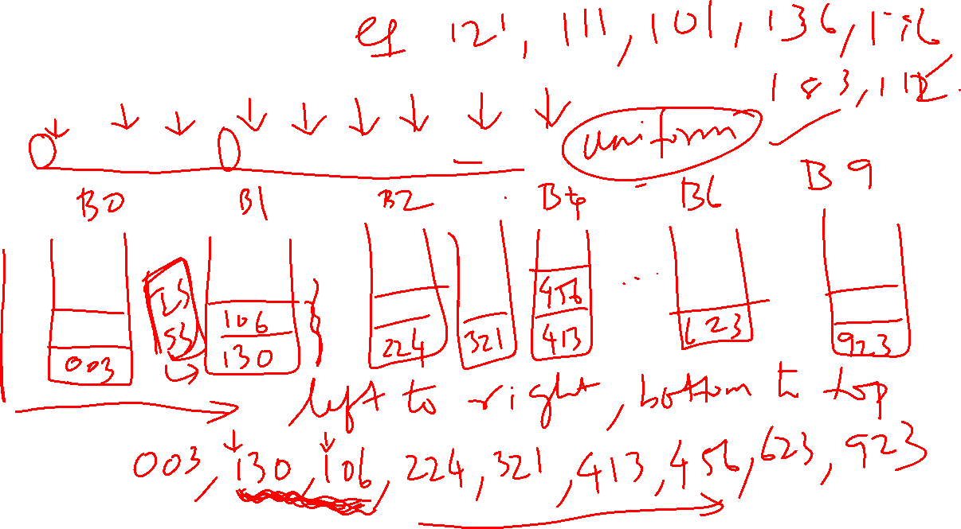
Bucket sort
130, 413, 224, 106, 923, 456, 321, 003, 623

Slide 53
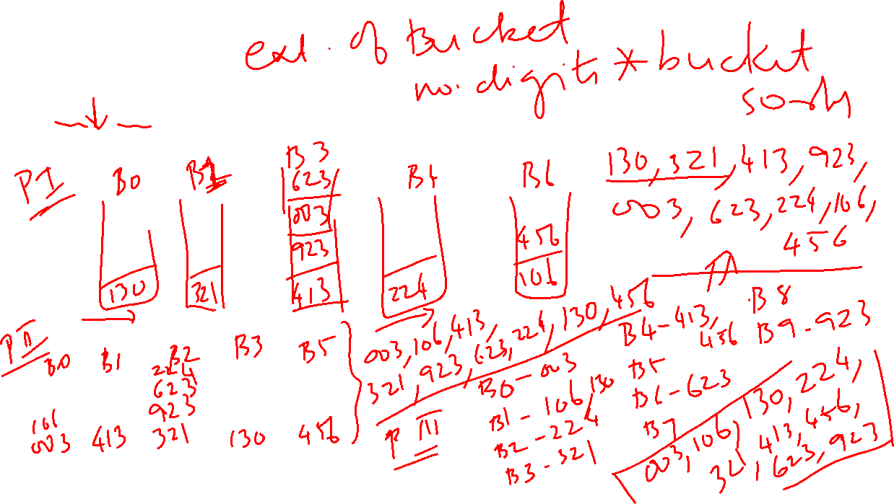
Radix sort
130, 413, 224, 106, 923, 456, 321, 003, 623

Slide 54
Comparison of Sorting algorithms
Sorting Algorithms
Algorithm | Best Case (Ω) | Average Case (θ) | Worst Case (O) | array already sorted.. | Inplace? | Stable?
Bubble sort | n | n² | n² | Best case | Yes | Yes
Selection sort | n² | n² | n² | NIL | Yes | No (at times)
Insertion sort | n | n² | n² | Best case | Yes | Yes
Heap sort | nlogn | nlogn | nlogn | NIL | Yes | No
Quick sort | nlogn | nlogn | n² | Worst case | Yes | No
Merge sort | nlogn | nlogn | nlogn | NIL | No | Yes
Bucket sort | n+k | n+k | n² | NIL | No | Yes
Radix sort | (n+k)d | (n+k)d | (n+k)d | NIL | No | depends on the algorithm
Counting sort | n+m | n+m | n+m | NIL | No | Yes
n – input size, k – buckets, d – maximum digit count in the input number, m – maximum number (range) in the array

Slide 55

Categories
Comparison based sorting
Bubble sort
Insertion sort
Selection sort
Merge sort
Heap sort
Quick sort
Non-comparison based sorting
Radix sort
Bucket sort
Counting sort
Internal sorting
Bubble sort
Insertion sort
Selection sort
Heap sort
Quick sort
Radix sort
Bucket sort
Counting sort
External sorting
Merge sort

